Slide 1



Welcome to
‘Requesting an EHC Needs Assessment’ Workshop
Workshop by Walsall SENDIAS Service
Notes:
Welcome & aim of session
Ground rules, housekeeping & questions
Use chat function
Questions at end
For individual support we will follow up outside of meeting

Slide 2

What is an (EHCP)?
An Education, Health and Care plan (“EHCP”) is a legal document which describes a child or young person’s special educational needs, the support they need, and the outcomes to be achieved.
The special educational provision described in an EHCP must be provided by the local authority (LA).
A plan can give a child or young person extra educational support and also more choice about school or settings.
Notes:
EHC plans are for children and young people whose special educational needs require more help than would normally be provided in a mainstream education setting (a college, school, and nursery).
Although the plan can include health or social care needs, your child will not get a plan if they only have health or social care needs that do not affect their education.
An EHC plan can be issued to a child or young person between the ages of 0 and 25 years.
We will run further sessions about a plan and what it looks like / more detail about content.

Slide 3


How can my Child/Young Person Obtain an EHCP?
In order to obtain an EHCP then an Education, Heath and Care needs assessment will be carried out.
This will assess the educational, health and care needs of the child/YP
First step, request an EHC needs assessment.
Notes:
EHC plans are drawn up by the local authority after an EHC needs assessment. The EHC needs assessment is the first step in getting a plan.

Slide 4

EHC Needs Assessments
Who can request an EHC needs assessment?
Parents- It is helpful to speak to school/college first to discuss this and your concerns
School or College- Can make the request for the child/young person
Young person- Aged 16 and over (but under the age of 25) can make the request themselves, if they do not understand, remember things or cannot communicate decisions then the parent / carer can make the request on their behalf
Notes:
Parents, school or college or the young person.
It will be helpful to speak to the school or college about your worries before writing to the LA. You should speak to the relevant class or subject teacher, the school SENCO or the person at the college responsible for SEN provision, and the head teacher or the principal.

Slide 5
Requesting an EHC Needs Assessment
Requests for EHC needs assessment are made via an online portal: Walsall’s EHC Hub or via a postal request.
The Hub can be found at http://ehchub.walsall.gov.uk/
When considering the request the LA will consider (The legal Test):
whether the child or young person has or may have special educational needs (“SEN”); and
whether they may need special educational provision to be made through an EHC plan.
( If the answer to both of these questions is yes then the LA must carry out an assessment. As outlined in Section 36(8) of the Children and Families Act 2014)
Notes:
New Hub recently launched and all applications now go through that, It will provide a secure shared touch point for everyone involved in the assessment and planning process and the annual review process, enabling them to make their views known and see the contributions of others as they work towards positive outcomes.
It puts the child or young person at the heart of the process, allowing families to take more ownership of their plans by developing confidential personalised profiles of their child and sharing their views and aspirations. It also provides secure online access to key documents and reports.
Practitioners will be able to submit information and advice online, avoiding any unnecessary delays with the delivery of paper based reports, while families will be able to see this at the same time that the council receives it.
In addition, the hub will contain information about EHCP meetings, including details of who will be attending, and enable families to provide their views online.
letter template still an option although mixed responses from parents we have spoken to so far– will circulate video explaining it after the session.
Show website

Slide 6
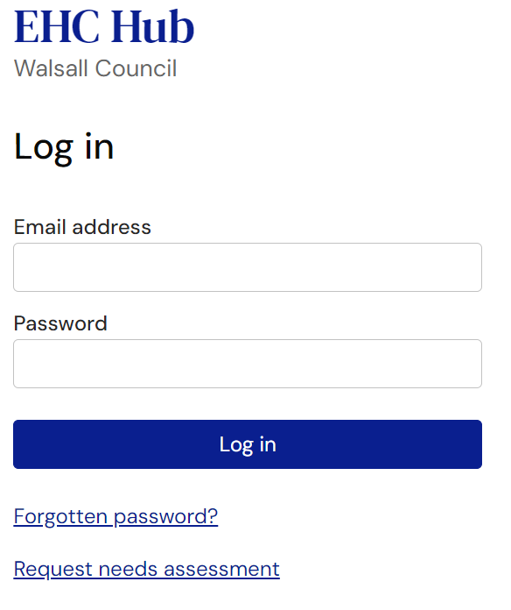
Walsall EHC Hub continued
Walsall local authority (SEN Team) require that the Parental/Young Person’s information is submitted for the for Education, Health and Care needs assessment request via their online EHC Hub.
When you wish to make a request, click the request a needs assessment tab as shown below.

Slide 7

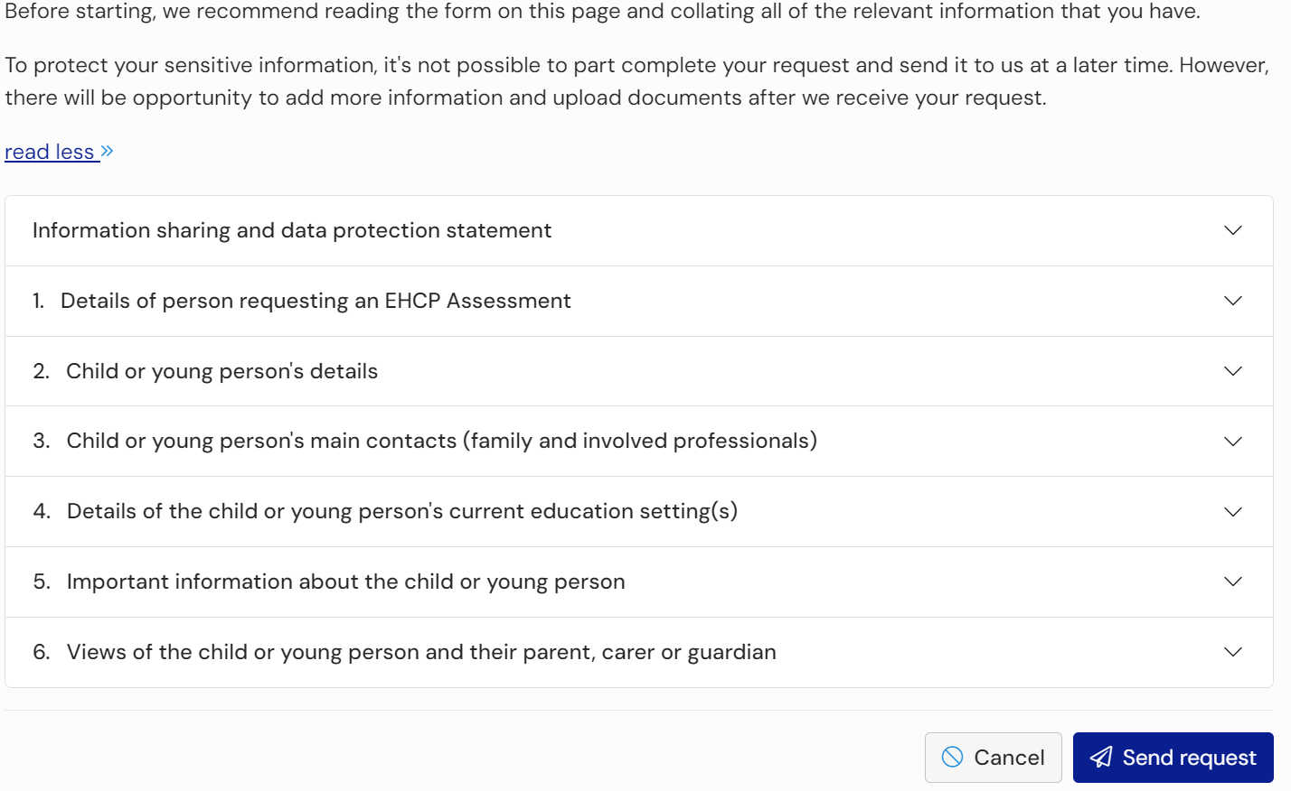
What will the EHC Hub form ask me?

Slide 8
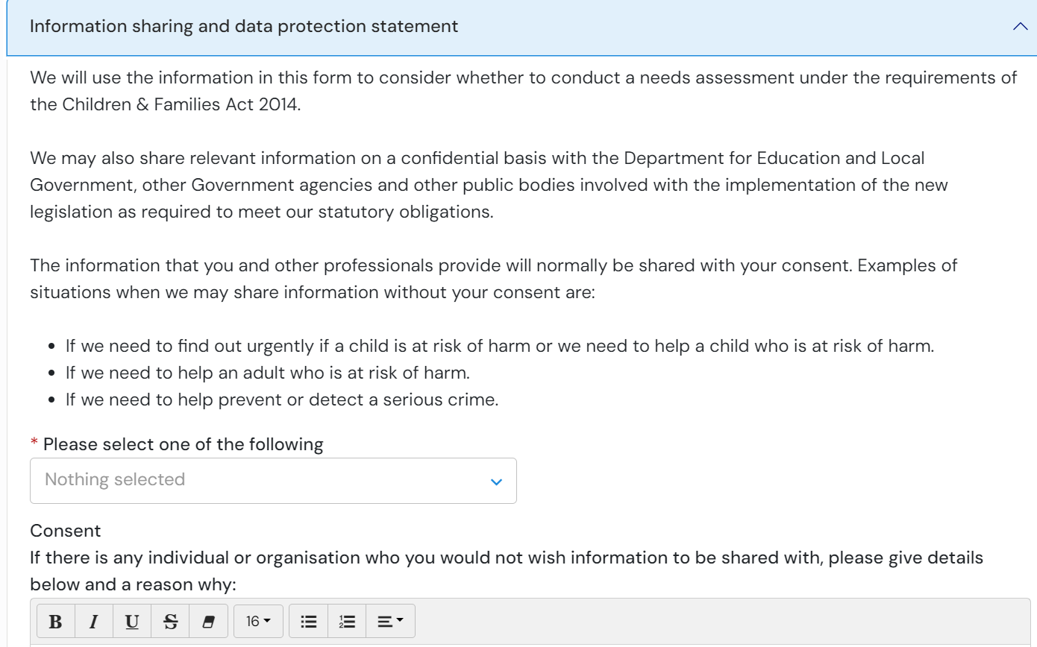
Online Hub …
The first step is complete the data protection information and details of the person making the request (parent or young person over 16 years of age).

Slide 9
Making the request
Section 1- Details of the person making the request
Section 2 – Your Child’s details
Section 3 – Anyone who is supporting your child
(put your own details in again along with any professionals)
Suggested contacts may include:
School contact / SENCo
CAMHS
School Nursing
Community Paediatrician
Child Development Centre
Speech and Language Therapist
Occupational Therapist
Physiotherapist

Slide 10
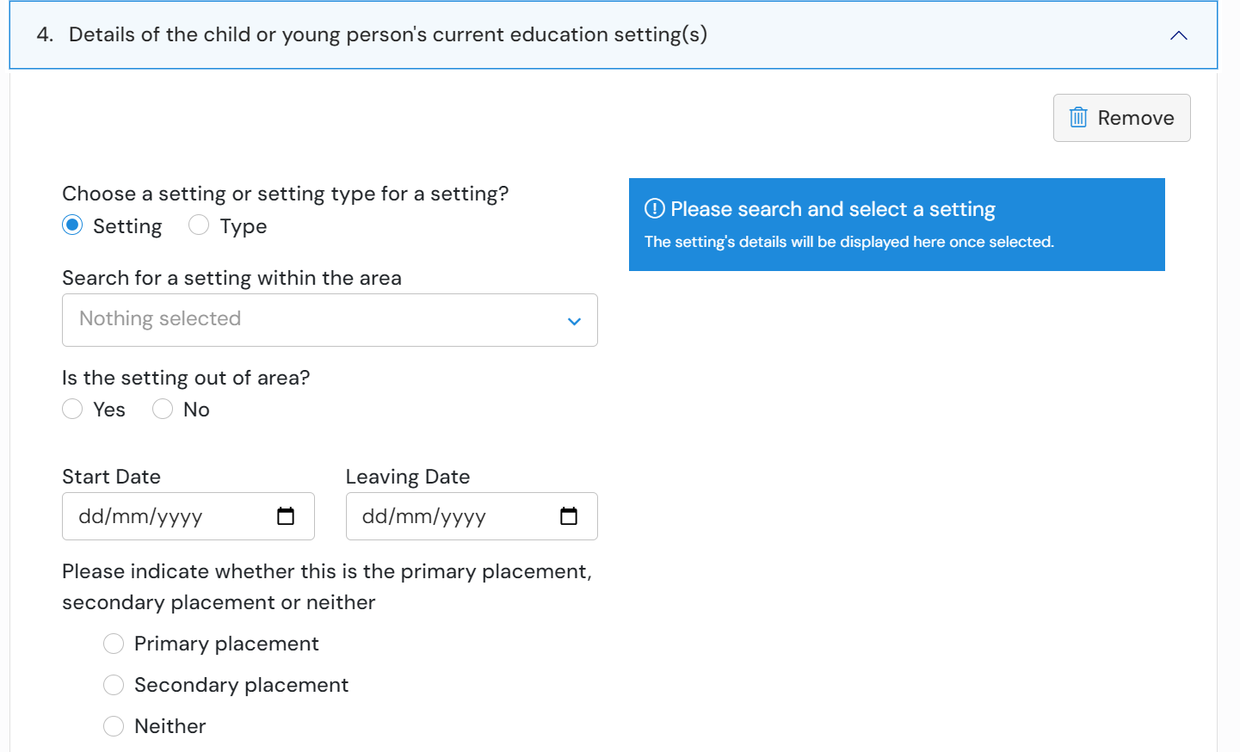
Making the request
Section 4 – Add details about the education setting

Slide 11

Making the request
Section 5 - Important information about the child or young person
The first section is: What information about the child or young person's Special Educational Needs (SEN) is relevant?
The second section is: to complete is around health needs:
The Third section to complete is: around social care needs
(use the guide to go through with parents during the session)

Slide 12
Section 5 – SEN Needs:
My child/young person’s/my early years until starting school.
What I am/my child/young person/ is like at home?
My child/young person’s/my strengths and what I am/he/she/ is good at?
How my child/young person/I prefer to communicate?
What is important to my child/young person/me and what makes him/her/me happy?
What is your child/young person’s/my needs or difficulties and what does he/she/I need help with?
Education
What difficulties is your child/young person/you having at school/college?
What needs to change and how will that change make a difference to your child/young person/you?

Slide 13
Section 5 - Health needs -
Use this to explain any diagnoses and medication and what is working well/not working well regarding health. What support is he/she/you receiving or any medication.
- Are you currently awaiting assessments for anything? If so, what are the assessments for?
- What diagnoses does your child have?
- Is your child currently taking any medication and if so, what is this for?
- Are there any therapies being offered such as speech and language therapy/Occupational Therapy etc? How often?

Slide 14
Section 5 – Social Care Needs:
Use this to explain what is working well/not working well with regard to social care? What support is your child/young person/you receiving?
- Are Social Services or Early Help involved? If yes, consider outlining why
- How are you managing as a family to get out?
- Are you using Short Breaks service?
You can also include:
What your child is like socially? Can/do they make friends? Do they have positive relationships
Do they give eye contact
Are they able to socialise
Do they go out into the community – how does this affect them?
Do they have road safety awareness and danger awareness?
Are they vulnerable?

Slide 15
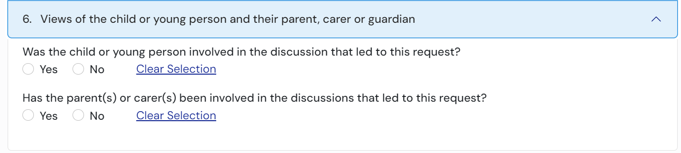
Making the request continued…
Section 6 - The final section allows you to add the views of the child, young person, their parent, carer or guardian
What they think is working well at school/home
What isn’t working well at school/home

Slide 16

Sumit the request

Slide 17

What happens once I submit my request?
You will receive an automated receipt of your request
Within three working days you should receive an email inviting you to make an account on the hub
Making an account will allow you to
  Track the progress of your EHCP request
  Add additional information
  Upload any supporting evidence (such as CAMHS letters, school reports, EP reports, SALT reports, OT reports, etc.)
You should receive the outcome of your request within 6 weeks

Slide 18
What happens after the Request to Assess?
The local authority must respond to the request within 6 weeks (this is required by regulation 4(1) of the Special Educational Needs and Disability Regulations 2014).
If they agree to assess then the EHC needs assessment will be carried out
If they refuse to assess then you have the right to appeal to the First Tier Tribunal
Details of appeal and mediation will be found on the letter the LA sent out you with the decision
Notes:
The LA must reply within six weeks (this is required by regulation 4(1) of the Special Educational Needs and Disability Regulations 2014). Always make a note of this deadline, you have the right to complain
They should always reply to you as a parent or young person – even where the request was made by the school or college.
They should always reply to you as a parent or young person – even where the request was made by the school or college.
The team at Walsall SENDIAS can help you with requesting an assessment and beyond.

Slide 19
Walsall SENDIASS
Thank you for taking the time to listen to this PowerPoint, we hope that it has been helpful ☺
Any queries or questions please contact us on:
Phone: 01922 612 008
Email: Walsallsendiass@family-action.org.uk
Please give us your feedback:
https://forms.office.com/e/hx65RqYTQd.

